Slide 1

“Emotions from text: machine learning for text-based emotion prediction”
(Group - 17)
Submitted to:
Annajiat Alim Rasel
Senior Lecturer
Department of Computer Science and Engineering,
Brac University
Submitted by:
Rakin Bin Rabbani (21366019)
Sumaiya Tanjil Khan (21366020)
Md Abu Ishak Mahy (21166039)
Prasenjit Das (21366036)
Shafkat Hassan (21166026)

Slide 2
Introduction
Text contains attitudinal information along with informative contents
Machine Learning: Supervised
Dataset: 22 fairy tales
Architecture: SNoW
Classification: Emotional and non-emotional (BOW approach)
Basic Problems:
What emotion or emotions most appropriately describe a certain text passage
Given a text passage and a specified emotional mark-up, how to render the prosodic contour in order to convey the emotional content

Slide 3
Previous Work
Implementation
Liu, Lieberman and Selker, 2003 researched sentence-level emotional affinity.
Six emotion categories: ANGER, DISGUST, FEAR, HAPPINESS, SADNESS, SURPRISE.
20 users’ preferences for email-client.
Sugimoto et al., 2004 deals with sentence-level emotion recognition for Japanese text-to-speech synthesis (TTS).
Naïve compositional approach is risky due to some linguistic factors.
Recognize emotional passages in terms of valence as in positive or negative.
Winnow update rule.
SNoW learning architecture.
Two cases for classification.
First case- emotional versus non-emotional or NEUTRAL,i.e. E = {N,E}.
Second case- emotional distinctions according to the valence, i.e. E = {N, PE,NE}.
10-fold cross-validation, 90% train data and 10% test data.

Slide 4
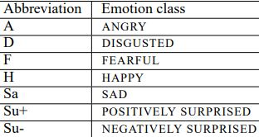
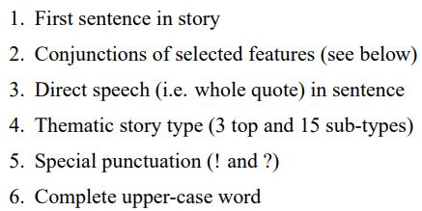
Data & Feature set
Approximately 180 children stories including Grimms’, H.C. Andersen’s and B. Potter’s stories as data .
To avoid any annotation bias, the data has been trained separately and work independently.
Each annotator marks the sentence level with one of eight primary emotions ( A, D, F, H, SA, SU+, SU- & Neutral).
Emotion annotation is hard, with the ratio of observed annotation overlap ranging between 45-64%.
The feature extraction was written in python.
SNoW only requires active features as input.
Feature vector size of around 30 features.
They were implemented as boolean values.
These continuous values were represented by ranges.
The ranges generally overlapped to get more generalization coverage.

Slide 5
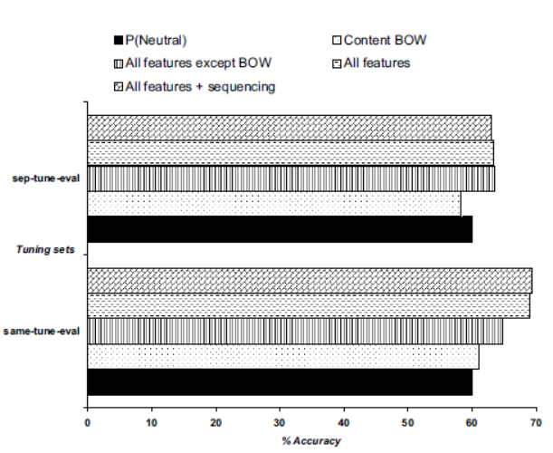
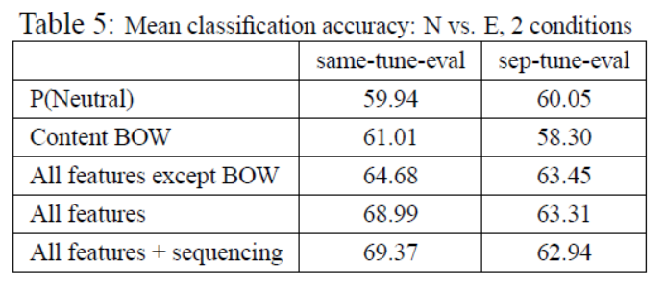
Parameter tuning
Based on 10-fold-cross validation.
sep-tune-eval -- 50% dataset used
same- tune-eval -- all data used
Classification result
Features work together. Removing any group degraded performance.
There is no true independence.
Features contribution was sensitive to parameter tuning.
Three issues:
Small data.
Data is not easily separable.
Emotion class is combined by basic emotion labels rather than an original annotated label.

Slide 6
Refining the Model
The instances are classified both in the binary (N vs E) and the tripartite polarity task (N, NE, PE):
1a E/NE: Then he offered the dwarfs money, and prayed and besought them to let him take her away; but they said, ”We will not part with her for all the gold in the world.”
1b N: And so the little girl really did grow up; her skin was as white as snow, her cheeks as rosy as the blood, and her hair as black as ebony; and she was called Snowdrop.
2a E/NE: “Ah,” she answered, “have I not reason to weep?
2b N: Nevertheless, he wished to try him first, and took a stone in his hand and squeezed it together so that water dropped out of it.

Slide 7
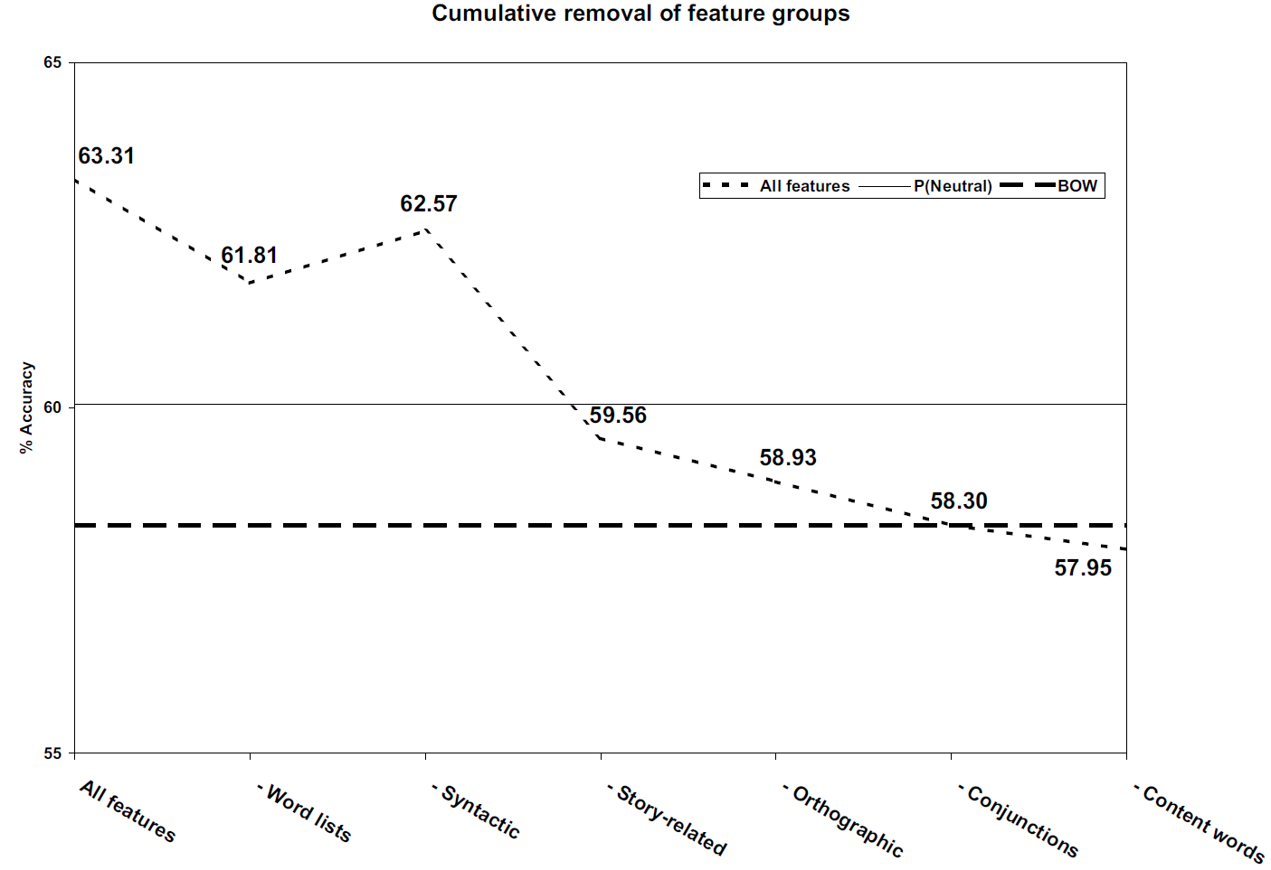

Slide 8
Future Works and Conclusion
use a larger data set to conduct a more complete study to establish mature findings
explore finer emotional meaning distinctions, by using a hierarchical sequential model
refining and improving the feature set, and given more data, tuning can be improved on a sufficiently large development set.
Use child-directed text-to-speech synthesis to investigate the Text-based Emotion Prediction problem in the domain of children’s fairy tales.
a research agenda for solving the Text-based Emotion Prediction problem more broadly

Slide 9
The End

